Slide 1


CAR PRICE PREDICTION – POWER BI PROJECT
BY: THARANI VENKATESH

Slide 2
PROJECT OBJECTIVE
“The main goal of this project is to use data visualization and DAX measures to identify patterns in car prices. This can help buyers, sellers, and dealerships make informed decisions when pricing used cars.”

Slide 3
DATASET OVERVIEW
The dataset contains details of used cars, including attributes like:
Brand
Model
Year
Transmission Type
Fuel Type
Mileage
Engine Size
Car Price
Source: Kaggle

Slide 4
DATA CLEANING PROCESS
Steps Performed:
Handled missing values in engine_size, mileage, and price
Changed data types for year, price, and mileage
Converted coded numeric fields into categorical labels (e.g., fuel type, transmission)

Slide 5
DAX FUNCTIONS
Data Analysis Expression(DAX Function)
Average Price = AVERAGE(car_price_prediction[Price])
Avg Mileage by Fuel = CALCULATE(AVERAGE(car_price_prediction[Mileage]), ALL(car_price_prediction[Fuel Type]))
Brand Share (%) = DIVIDE(COUNT(car_price_prediction[Car ID]), [Total Cars], 0)
Total Cars = COUNT(car_price_prediction[Car ID])
Total Sales = SUM(car_price_prediction[Price])
TotalCarsSold = COUNT(car_price_prediction[Car ID])
Unique Brands = DISTINCTCOUNT(car_price_prediction[Brand])
Cars per Year = COUNT(car_price_prediction[Car ID])

Slide 6
DASHBOARD SUMMARY
Features Highlighted:
Bar chart of Average Price by Brand
Slicer for Transmission and brands
Donut chart showing car count by fuel type
Table with car details and pricing
Card visuals showing KPIs (e.g., Total sales, Average Price, Unique brands)

Slide 7
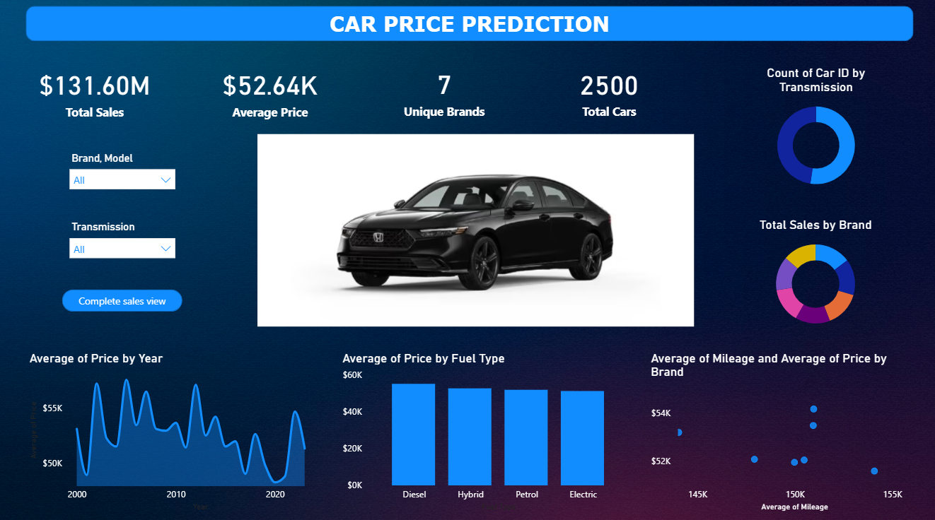
DASHBOARD

Slide 8
INSIGHTS
Brand Influence:
Brands like BMW, Audi, and Toyota command higher average prices.
Fuel Type:
Petrol cars dominate the listings, but diesel cars tend to be priced higher.
Transmission:
Manual cars are generally cheaper than automatic ones.
Model Year:
Newer cars have significantly higher prices.
Engine Size:
Positively correlates with price — bigger engines → higher price.
Mileage:
Higher mileage slightly lowers car price, but this effect is moderated by brand reputation.

Slide 9
CONCLUSION
“In conclusion, Power BI helped me understand how different features influence car prices. By using DAX and visuals, I created an interactive dashboard that provides insights useful for car buyers, sellers, and dealerships. This project improved my skills in data cleaning, modeling, and visualization.”

Slide 10
THANK YOU

